Slide 1


Docker

Slide 2

Kahoot Time!

Slide 3
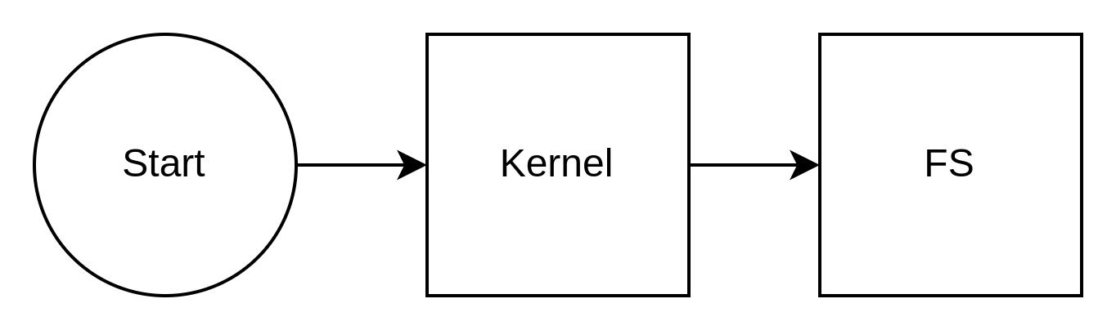
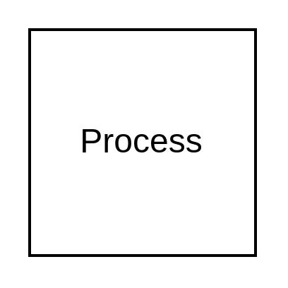
Стандартний boot

Slide 4
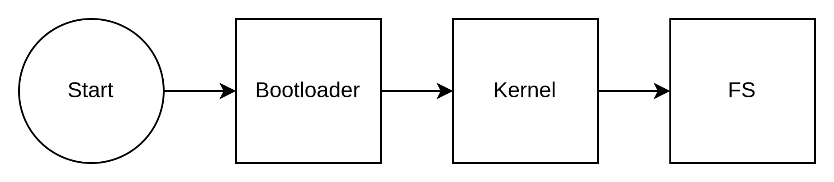
Dual-boot

Slide 5
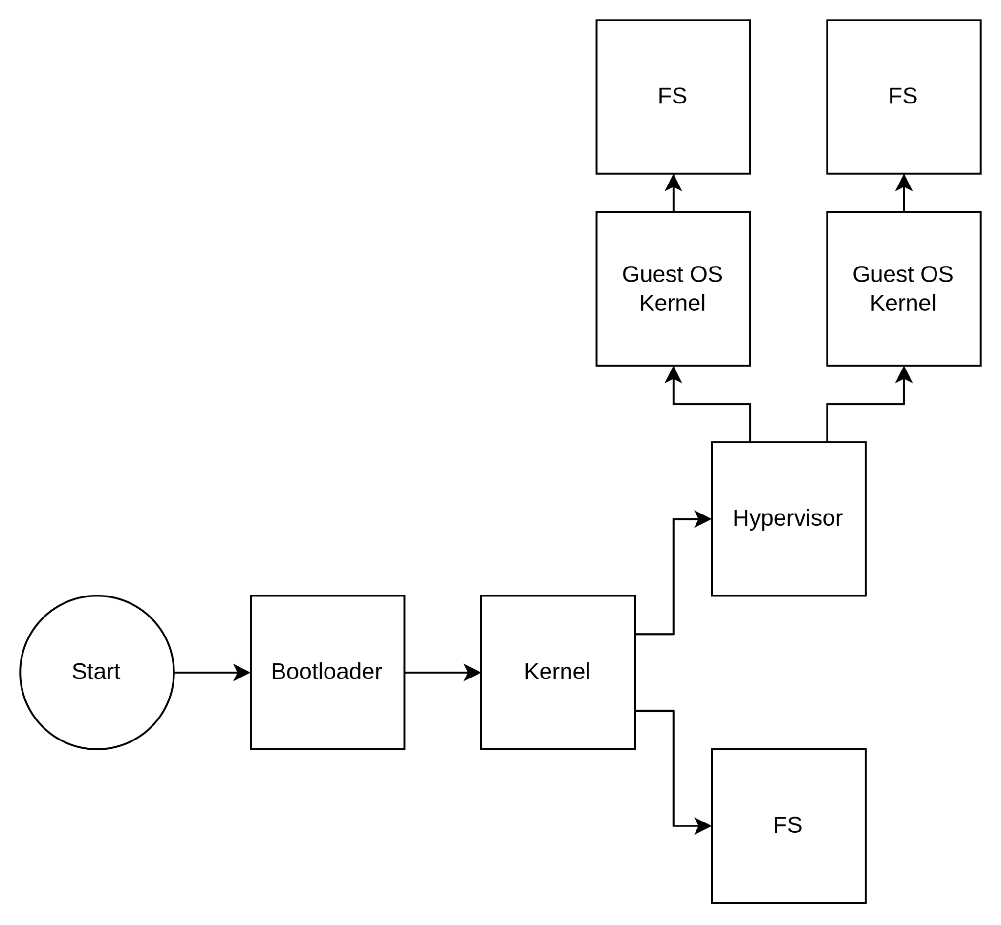
Virtualization(Type 2)

Slide 6
Cgroups
cpuset - assigns individual processor(s) and memory nodes to task(s) in a group;
cpu - uses the scheduler to provide cgroup tasks access to the processor resources;
cpuacct - generates reports about processor usage by a group;
io - sets limit to read/write from/to block devices;
memory - sets limit on memory usage by a task(s) from a group;
devices - allows access to devices by a task(s) from a group;
freezer - allows to suspend/resume for a task(s) from a group;
net_cls - allows to mark network packets from task(s) from a group;
net_prio - provides a way to dynamically set the priority of network traffic per network interface for a group;
perf_event - provides access to perf events) to a group;
hugetlb - activates support for huge pages for a group;
pid - sets limit to number of processes in a group.

Slide 7
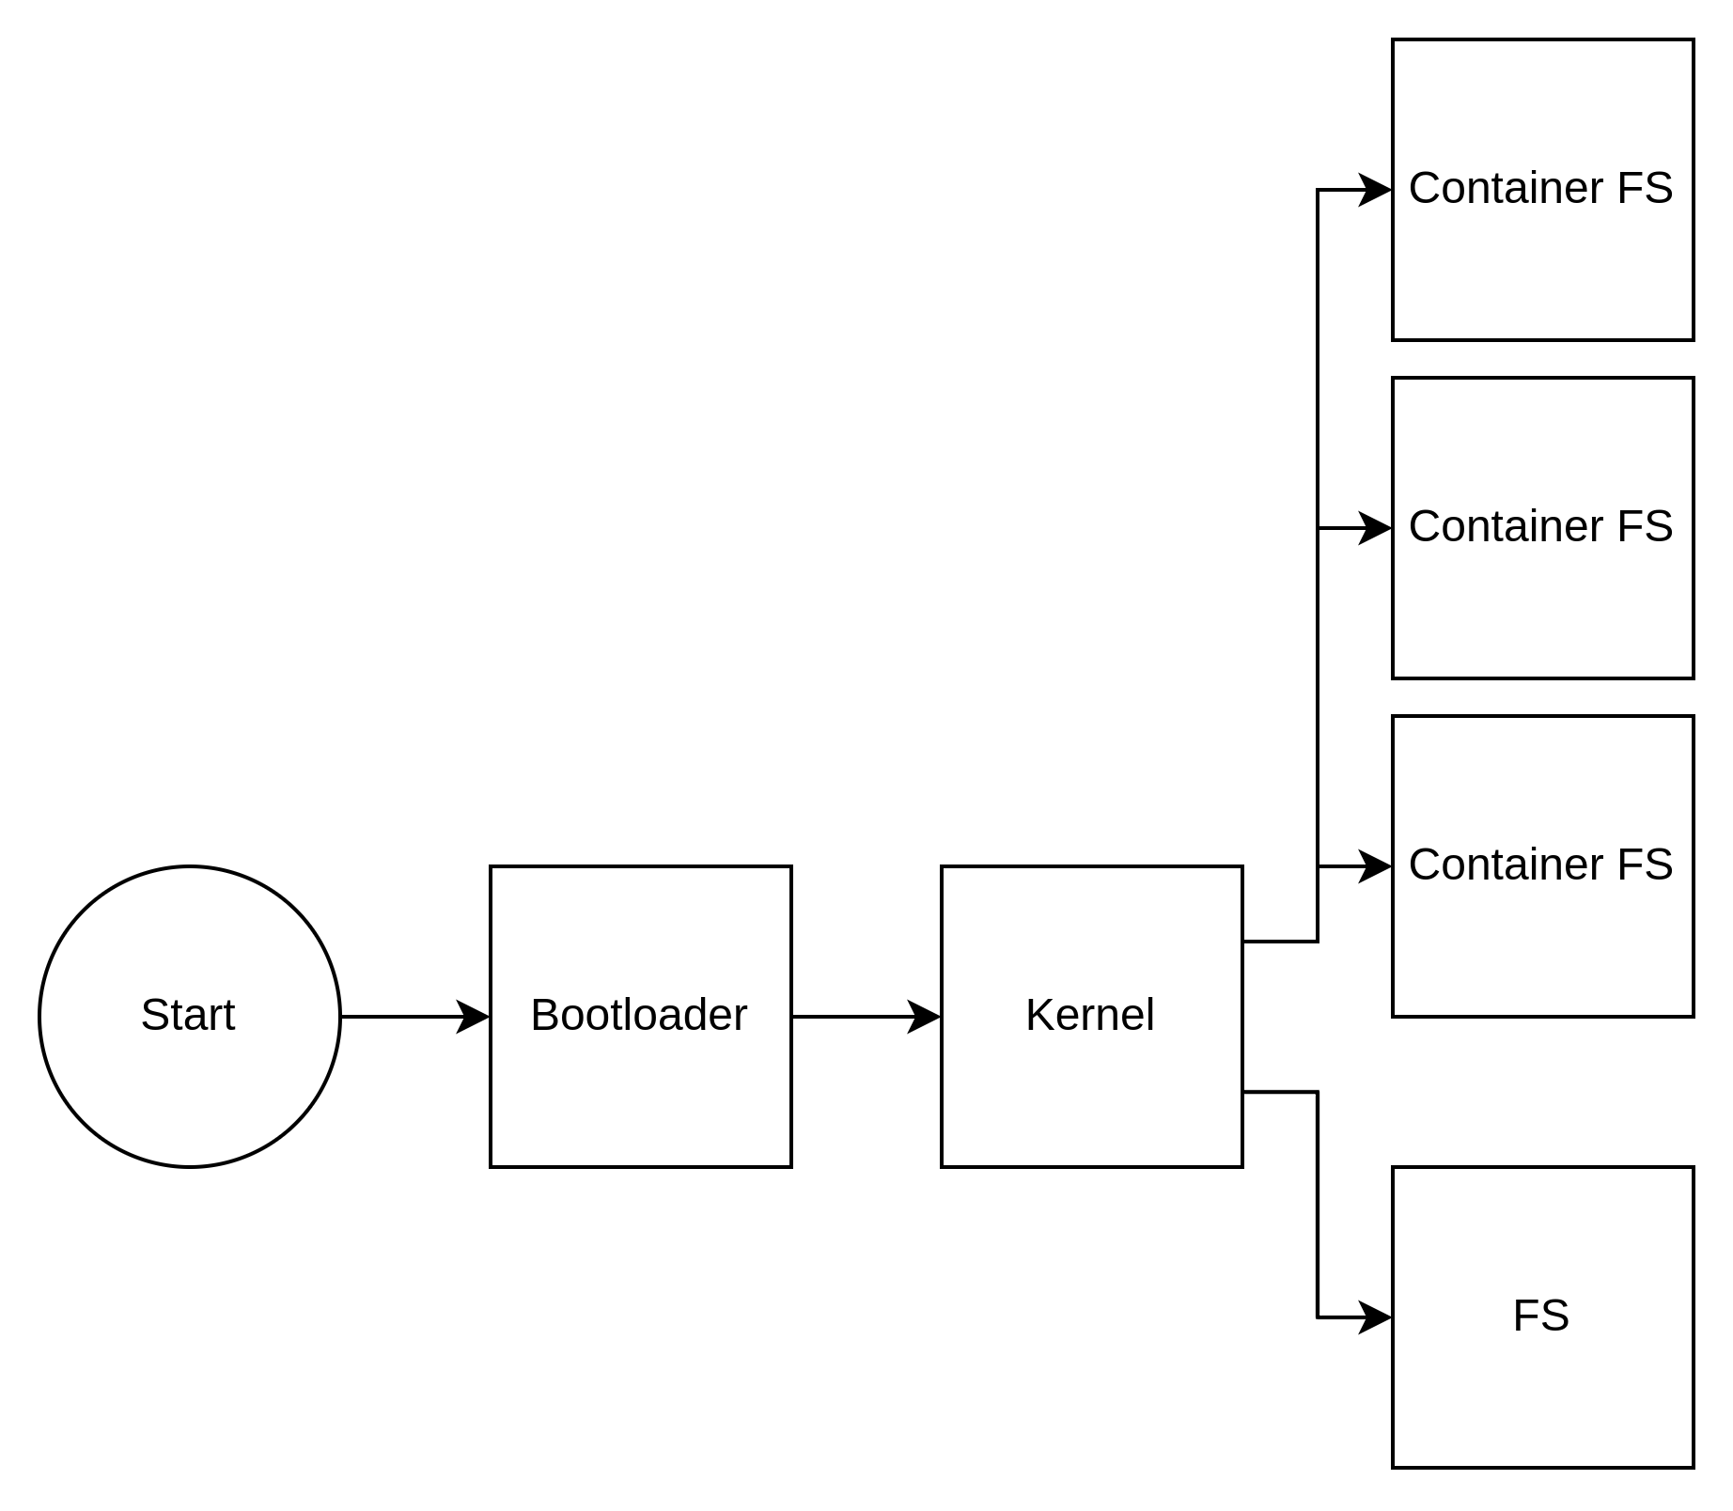
Containerization

Slide 8
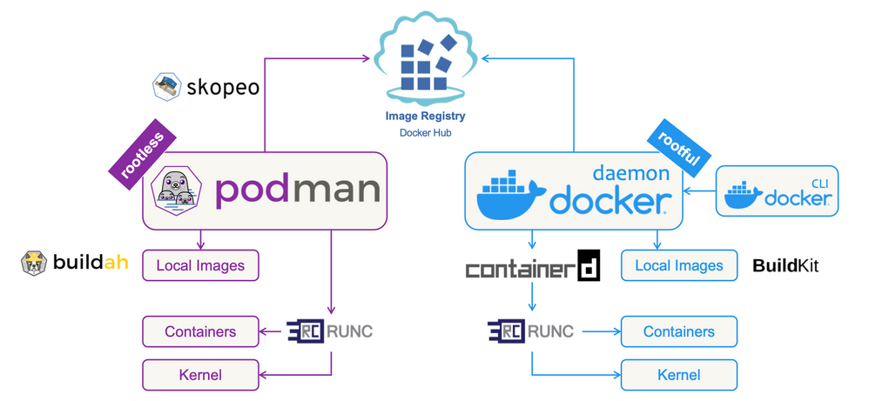
Automation

Slide 9
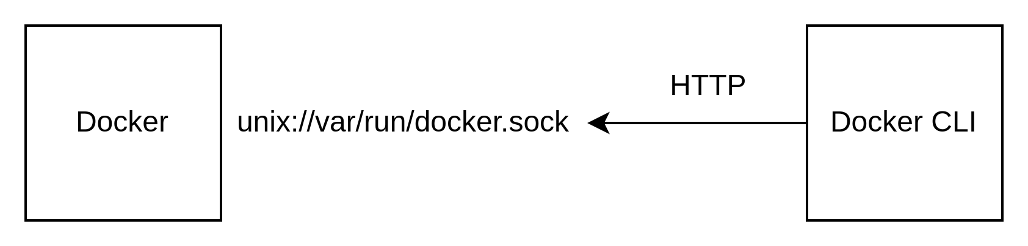
Docker

Slide 10
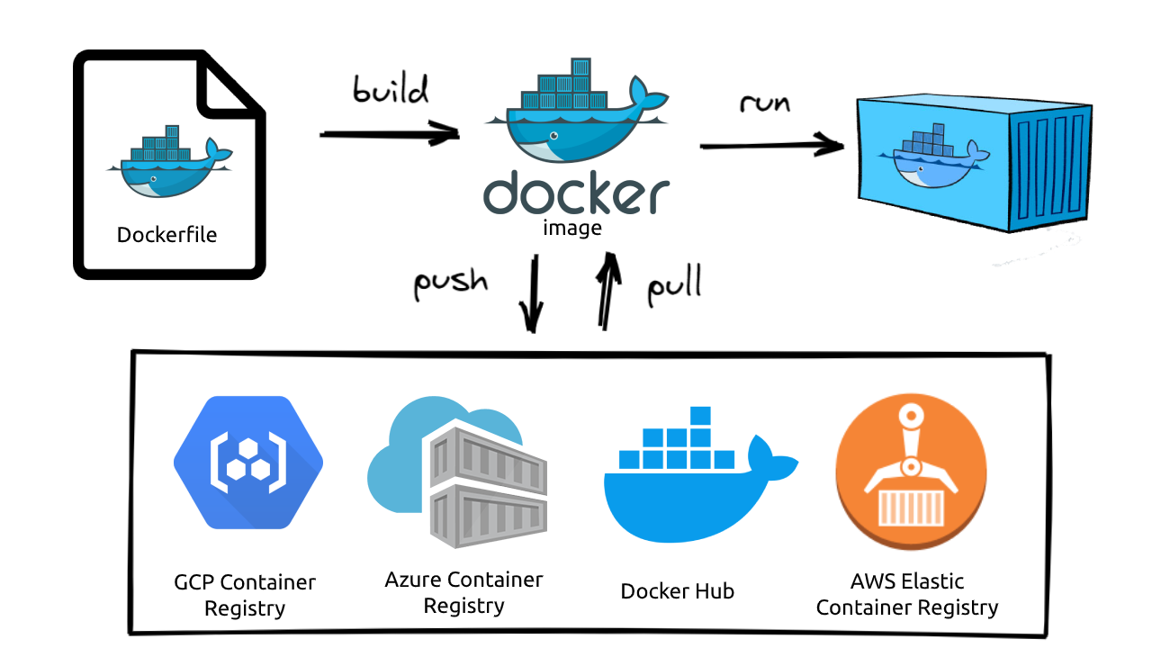
Docker

Slide 11
Docker
Live coding time

Slide 12

Дякую

